Slide 1
The Small World Phenomenon
An Algorithmic Perspective

Slide 2
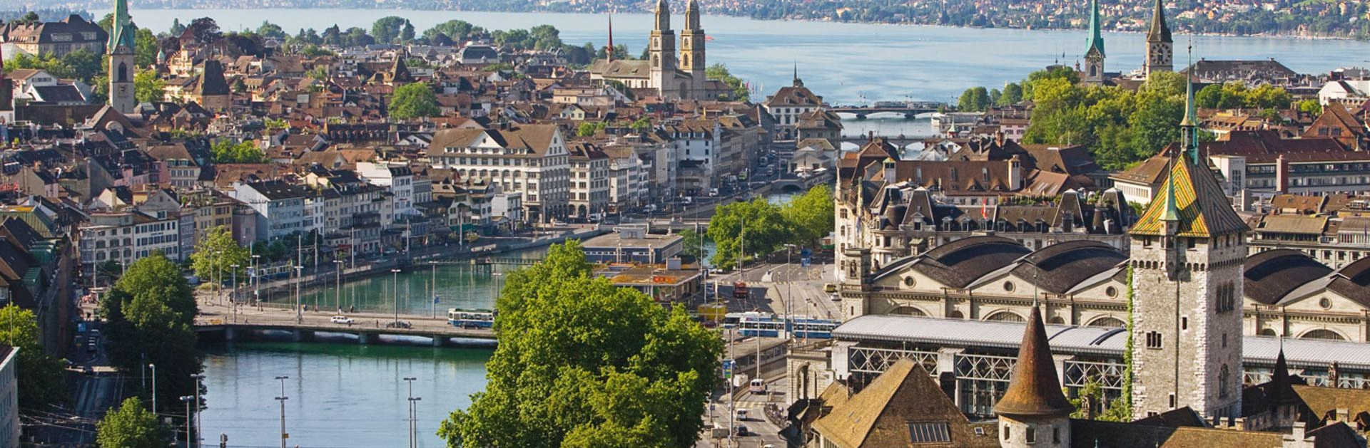
Introduction
The six degrees of separation
The two degrees of separation in Zürich
Anecdotal evidence?
Notes:
- Six degrees of separation in milgrams experiment

Slide 3
Two Questions to answer:
Are we separated by only 6 links to any other person in the world?
Could we efficiently construct such a short route to any other person?
Notes:
1st existential
2nd algorithmic

Slide 4
Milgram’s Experiment
Deliver a letter to a random other person => only within USA
Average count of steps was around 6
It seems…
These shorts paths do not only exist, but they are efficiently constructable by humans.
Could we efficiently construct such a short route to any other person?
Notes:
- Only first name, occupation and location given

Slide 5
Milgram’s Experiment
Extracting Milgrams results
$a∗{log⁡(300 million)}^{2}≈$ 6
$⇒a ≈\frac{1}{12}$
Degrees of separation in the world:
$\frac{1}{12}∗{log⁡(7 billion)}^{2 }$ $≈$8
degrees of separation in Zürich:
$\frac{1}{12}∗{log⁡({400}^{′}000)}^{2 }$ $≈$2.5
Are we separated by only 6 links to any other person in the world?
Notes:
Extracting milgrams results and applying it to the result we will derive later from theoretical results

Slide 6
Construction of Graph
Why a graph?
Mix of Close and Long range contacts seems optimal
Notes:
People as vetcies, acquiantances as edges -> natural
Only Close or Long => cannot solve our problem in fast runtime

Slide 7
Construction of Graph
p = 1 diameter of the local circle
q = 1 count of long-range contacts
n = 6 width/height of the lattice
Notes:
Lattice is square

Slide 8
Problem at hand
message holder h
target t
Message delivered to t as fast as possible
h can only send to its own contacts
Notes:
u: milgrams experiment => first person given letter
T: milgrams experiment => person that the letter should be delivered to
With the knowledge u has => deliver as fast as possible

Slide 9
The two (three) things h knows
the set of local contacts among all nodes (i.e. the underlying grid structure);
the location, on the lattice, of the target t; and
the locations and long-range contacts of all nodes that have come in contact with the message.
Notes:
Go back a slide and show the points
Even with 3) we can get same upper bound
And without 3) same lower bound => makes result stronger

Slide 10
Probability distribution of long range contacts
$d(u,v)$ is the distance between u and v on the lattice
Introduction of parameter r
The larger r, the closer the long range contacts
If r = 0, long range contacts are uniformly randomly distributed
P[»Long range contact of u is v»] = $\frac{{d(u,v)}^{−r}}{\sum_{v }{{d(u,v)}^{−r}}}$
Notes:
P sum = 1
We will now play with the value of r

Slide 11
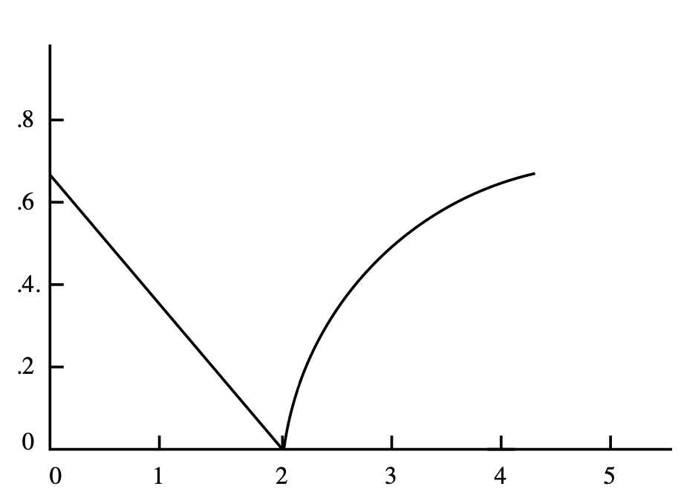
Three Theorems of this Paper
$r=0$ => slow
r = 2 and p = q = 1 => fast
$0 ≤r <2 OR 2 < r$ => slow
Notes:
All else being equal, we will play with the value for r from now on.

Slide 12
Three Theorems of this Paper
Notes:
Theorem 2 less strong because p,q fixed

Slide 13
Three Theorems of this Paper
Notes:
All else being equal, we will play with the value for r from now on.

Slide 14
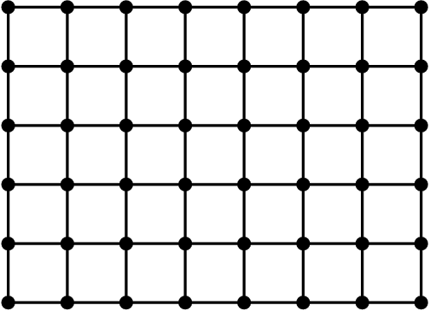
Upper Bound for r = 2
Principle of deferred decisions
p = q = 1
Probability that v is long range
contact of u:
$\frac{{d(u,v)}^{−2}}{\sum_{v }{{d(u,v)}^{−2}}}$
Notes:
“Principle of deferred decisions: message reach node -> long range contacts generated

Slide 15
Proof Ingredient 1. (Ripple Pattern)
$$\sum_{v≠u }{{d(u,v)}^{−2}}≤ \sum_{j=1}^{2n − 2}{\left(4j\right)\left(j^{−2}\right)}$$
…
$≤4 ln⁡(6n)$
Pr[“u chooses v”]
${≥[4\ln\left(6n\right){d(u,v)}^{2}] }^{−1}$
Notes:
Here, interpret j as the lattice distance

Slide 16
Let’s slice our problem into phases
Our algorithm is in phase j if the lattice distance from the current message holder to the target is between 2^{j} and 2^{j} ⁺ ¹
B^{j} = set of nodes within distance 2^{j} of t
Phase n
Phase n -1
Phase n - 2
Notes:
Note that it can skip phases
Give listeners an intuition as to why r = 2 is the optimal solution

Slide 17
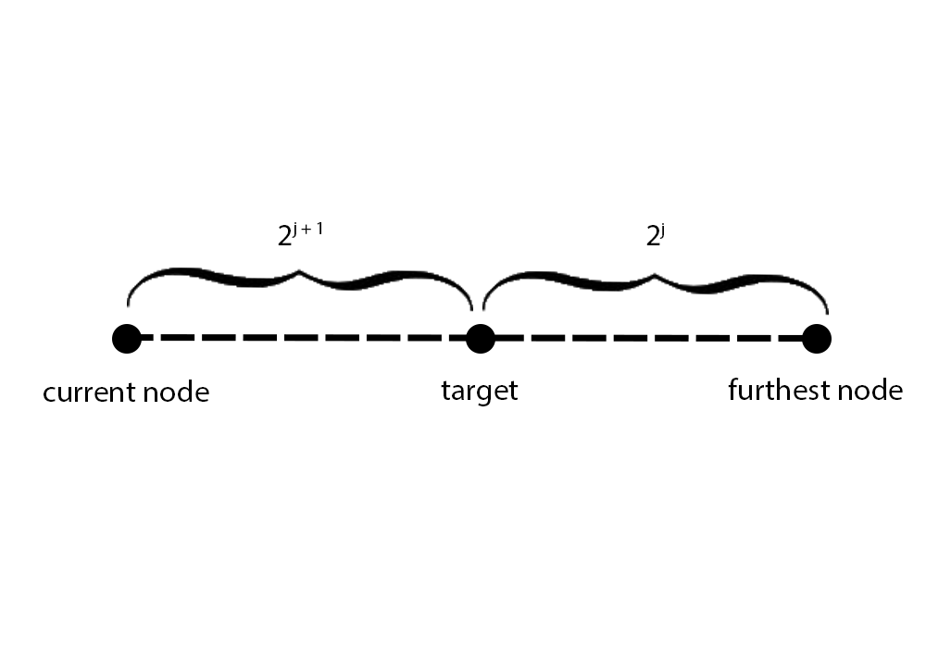
Proof Ingredient 2.
B^{j} = set of nodes within distance 2^{j} of t
There are atleast $1+ \sum_{i=1}^{2^{j}}{i}= … >2^{2j −1}$ nodes in B^{j}
Max distance between cn and fn: $2^{j+1}+ 2^{j}< 2^{j+2}$
The message enters B^{j} with probability at least
$\frac{{2^{2j −1} ∗ d(u,v)}^{−2}}{\sum_{v }{{d(u,v)}^{−2}}}=\frac{2^{2j −1}}{4\ln{{\left(6n\right){(2}^{j+2})}^{2}}}=\frac{1}{128\ln{(6n)}}$
Notes:
Lowest bound for probability which comes from the further node from u

Slide 18
Putting it all together
Let X_{j} = total number of steps in phase j
Through geometric distribution with p $≥\frac{1}{128\ln{(6n)}}$
$𝔼\left[X_{j}\right]=\frac{1}{p} ≤128\ln{(6n)}$
Let X = total number of steps in our algorithm
Max log(n) phases because 2^{log(n)} = n^{log(2)} = n
$X= \sum_{j=0}^{log⁡(n)}{X_{j} ≤\left(1+\log\left(n\right)\right)∗(128\ln{(6n})) ≤ α{∗log⁡(n)}^{2}}$

Slide 19
Lower Bound for 0 $≤$r $<$ 2
p, q => any value
Use the ripple effect to estimate
Notes:
“Principle of deferred decisions: message reach node -> long range contacts generated

Slide 20
Some definitions
$δ$= some constant depending on r
$λ$ = some constant depending on p, q and r
Let U = ”Set of nodes within lattice distance ${pn}^{δ}$ of t”
Let event $ℰ′$ = “within ${λn}^{δ}$ steps we reach a node other than t that has a long range contact in U”
$\operatorname{Pr}\left[ℰ′\right]≤\frac{1}{4}$
Let event $ℱ$ = ”Lattice distance between s and t => greater than n/4”
$\operatorname{Pr}\left[ℱ\right]≥\frac{1}{2}$
Let event $ℰ$ = “within ${λn}^{δ}$ steps we are at t”
Let $X$ = “number of steps needed to reach t”

Slide 21
Let event $ℰ′$ = “within ${λn}^{δ}$ steps we reach a node other than t that has a long range contact in U”
Let event $ℱ$ = ”Lattice distance between s and t => greater than n/4”
Let event $ℰ$ = “within ${λn}^{δ}$ steps we are at t”
Let $X$ = “number of steps needed to reach t”
(i) $\operatorname{Pr}\left[ℰ |ℱ∧\overline{ℰ′}\right]$ = 0, hence $\operatorname{Pr}\left[X |ℱ∧\overline{ℰ′}\right]≥{λn}^{δ}$
(ii) $\operatorname{Pr}\left[ℱ∧\overline{ℰ′}\right]≥\frac{1}{2}∙\frac{3}{4}≥\frac{1}{4}$
=> $𝔼\left[X\right] ≥\operatorname{Pr}\left[X |ℱ∧\overline{ℰ′}\right]∙$ $\operatorname{Pr}\left[ℱ∧\overline{ℰ′}\right]≥\frac{1}{4}$ ${λn}^{δ}$

Slide 22
Conclusion
The graph modeled in our analysis seems to be pervasive in many aspects of our life. The following networks have been shown to exhibit such a structure:
World Wide Web
Social Networks
Neurons
…

